Slide 1
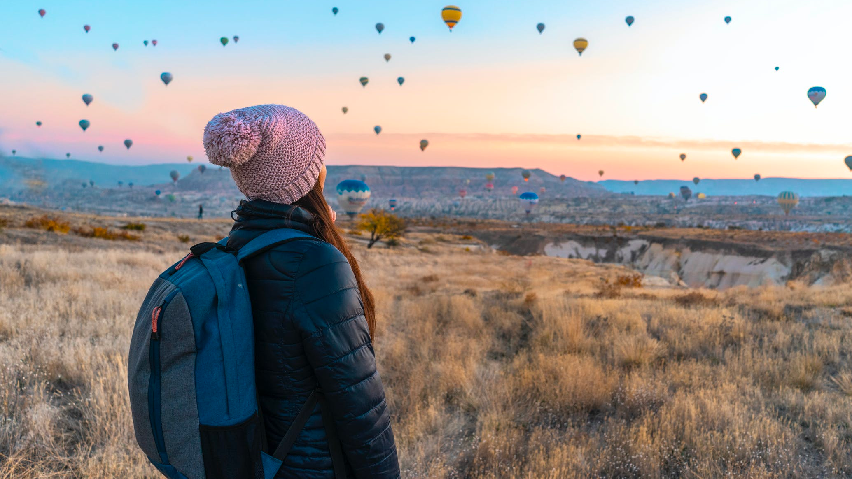

WanderOn
Team 4

Slide 2
Project Objectives
Today's Agenda
Design System
Target Audience
Personas
Key points for discussion
Research methods
Card sorting
User workflow
Error Handling
Usability Testing
Plane
Onboarding Screens
DEMO

Slide 3
Product Objectives
To provide an adventurous and joyful vacation experience to all age groups.
To provide a simple user-friendly registration process for the consumers
To provide consumers with individual bookings of rental cars, travel flight tickets,
accommodation services, etc.
To provide consumers with destination recommendations with respect to the seasons
To provide a stress-free vacation experience to the consumers by providing essential
services all in a single package
To provide offers to special users based on the travel history with us.
To provide travel recommendations to the consumers like local cuisines, historical
places, adventure-oriented activities via blogs
To provide a pre-planned schedule to the consumers about the trip in a single itinerary

Slide 4
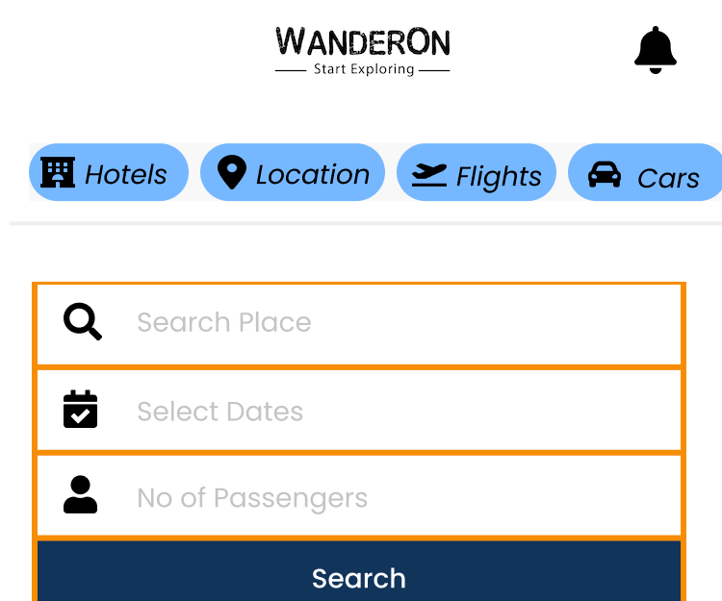
Design System
We have used a basic and catchy color palette with whites, blacks, and blues with Roboto and Poppins fonts.
The icons we have used are very easily understandable by all kinds of audiences.
The layout of the screens is of a basic iPhone with a width of 374 px and a height of 812 px.
The logo of our project is our brand name "WanderOn" with a tag line that says Start Exploring.
Key areas we are focusing on

Slide 5
Demographics – Includes people from cities and developed towns who generally use online apps to book trips and find it difficult to go in-person to agents. Includes mainly 9:00 – 6:00 work force with busy lives.
Age Group – 16 to 60 years
Psychographics – Fear of paying more to agents for trips and flights. Also, the fear of not finding any good deals.
Knowledge level – Almost all are educated and have an understanding and the need of application.
Technology Orientation – Mostly all are aware of technology and know how to operate apps on mobile phone.
Target Audience

Slide 6
Providing user-friendly travel application which is easy to use.
Designing a high-quality website with many features that comforts the users in terms of travel recommendations, flight reservation etc
Providing a perfect holiday package with complete relevant information needed for the trip
Take reviews of the website like how user-friendly the website is to look out for the packages
Moreover, collect feedback about the quality of the website whether it is reaching their expectations.
To know how quality is the customer support working if facing any issues
Collect responses from the users, how is the experience traveling with us in terms of hospitality.
Take feedback from each customer on how good the services are offered with respect to their age groups
Take feedback about their service whether it compensates the cost that charged
Collect responses whether users are successful in booking services that are redirected to the third-party sites from the website
User Needs

Slide 7
We have applied concept testing and tree testing methods in our project.
Concept Testing:
We conducted this to get feedback from the user on our idea in the early stages. The idea was addressed, and responses were logged
It helped us jot down the requirements needed to move forward with the prototyping.
We spoke to a group of individuals and understood the most essential functionalities that would be required.
It helped us gain insight into whether customers understood the idea and would want to use the product or feature.
Research Methods

Slide 8
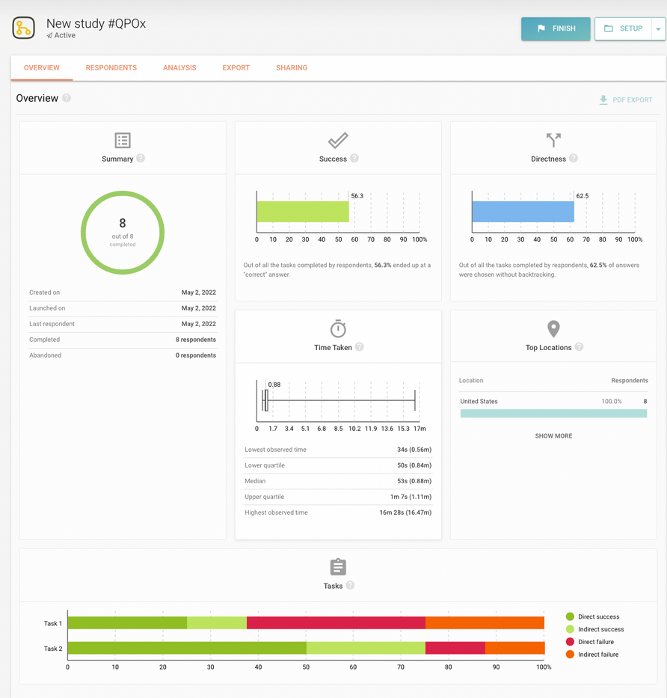
Tree Testing:
Research Methods
https://study.uxtweak.com/treetest/RT1tdzwfCPYUE1fA6iwmL
https://app.uxtweak.com/treetest/results/45983/overview

Slide 9
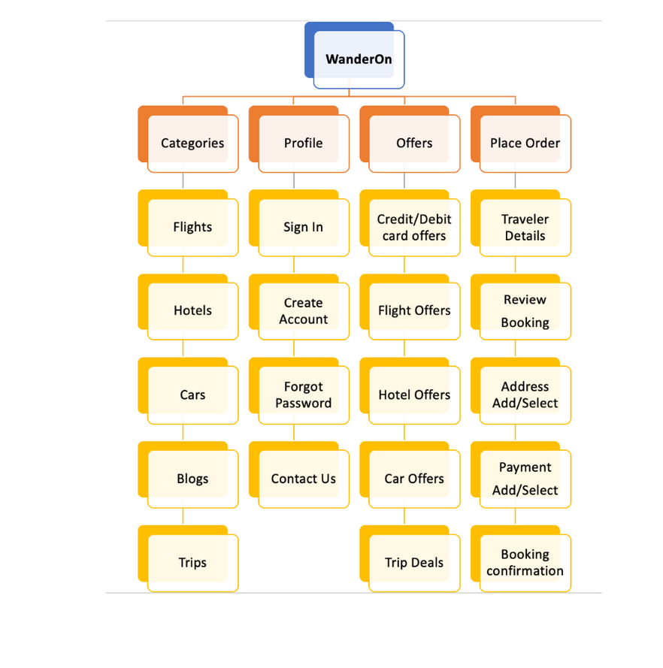
Open card sorting Information Architecture

Slide 10
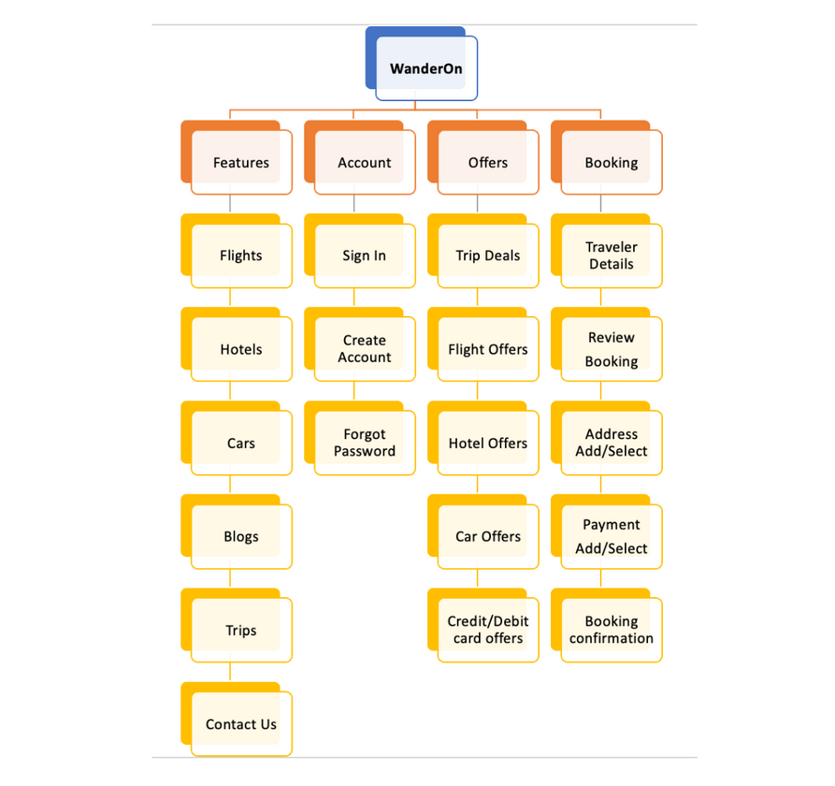
Closed card sorting Information Architecture

Slide 11
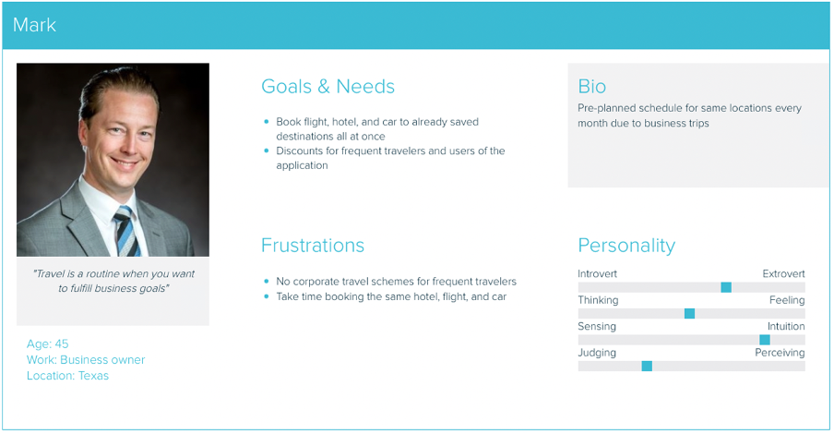
User Personas
Key areas we are focusing on

Slide 12
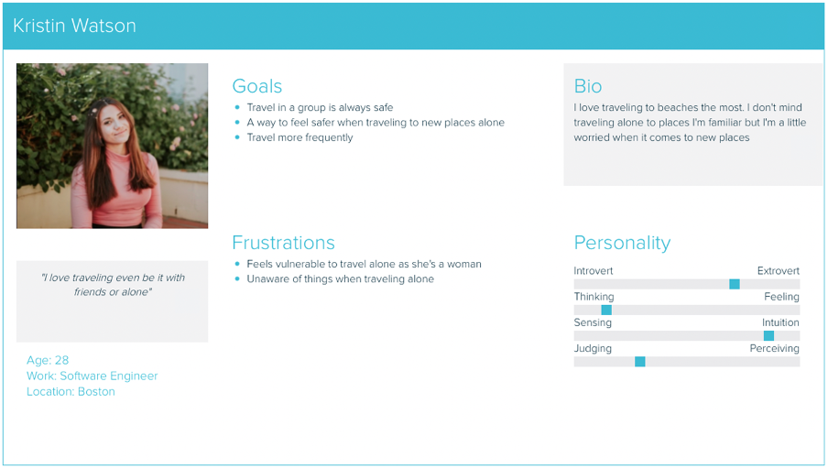
User Personas
Key areas we are focusing on

Slide 13
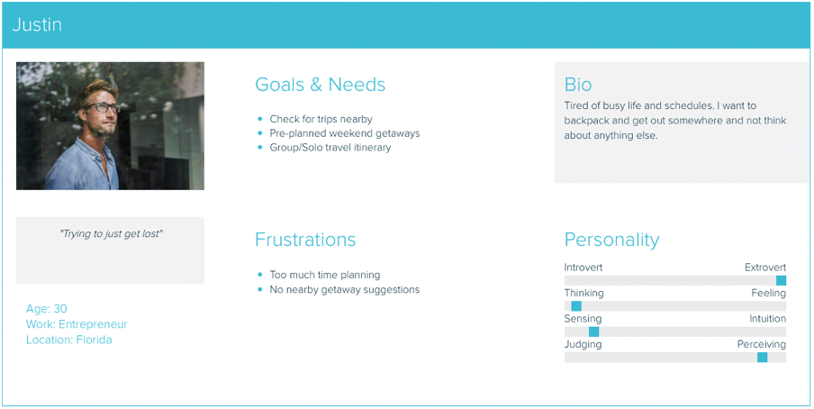
User Personas
Key areas we are focusing on

Slide 14
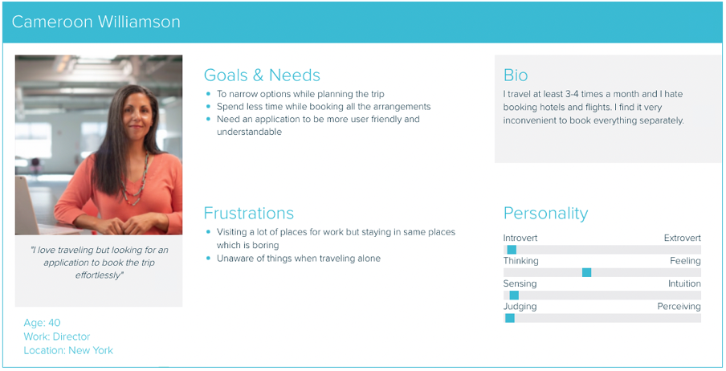
User Personas
Key areas we are focusing on

Slide 15
Let users know as soon as they make a mistake
Make errors prominent
Show error messages in context
Ensure messages are easy to understand and helpful
Error Handling

Slide 16
Conduct surveys to track the customer satisfaction with personalized travel experience
Collect reviews if users experienced successful bookings with redirected sites from Wanderlust website
Collect reviews about quality of the website response
Take feedback from each customer to analyze how different and how user-friendly the service is being offered to different age groups
Conduct surveys to learn about quality of customer support offered
Usability Testing Objectives and Tasks

Slide 17
The Strategy: We incorporated not only what the people running the product want to get out of it but what the users want to get out of the product as well.
The Scope: We defined the way in which the various features and functions of the product fit together.
The Structure: We defined the abstract structure of the product such as the arrangement of navigational elements etc;
The Skeleton: We defined the placement of buttons, controls, photos, and blocks of text to optimize the arrangement of these elements for maximum effect and efficiency
The Surface: On the surface, you see a series of pages, made up of images and text. Some of these images are things you can click on, performing some sort of function such as taking you to checkout page.
Planes

Slide 18
Onboarding Screen

Slide 19
Figma Prototype
https://www.figma.com/file/7HvpqWTaQ1RRZXsxI4zIDS/WanderOn?node-id=168%3A1393
Demo

